Slide 1
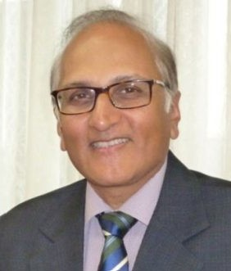
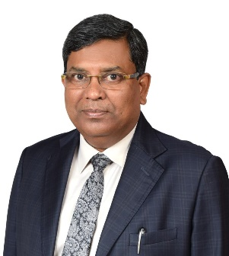
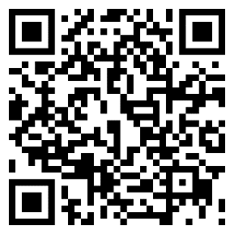
Conference on
Constructing Legal Foundations;
Navigating the future of Construction Law
LIVE IN PERSON
24th March 2024
Manipal Law School, MAHE, Govindapura, Yelahanka, Bengaluru
Chief Guest:
Justice S Ravindra Bhat
Proposed Agenda
Registration from 08:30 AM onwards
Inauguration 9:30 AM
Welcome address
Panel discussions
Session 1: 10:00 to 11:30 AM
Navigating the Procurement Puzzle
Session 2: 11:45 to 01:15 PM
Mastering Contract Administration; “From Ground-breaking to Handover”
Lunch break (01:15 to 2:00 PM)
Session 3: 02:00 to 03:30 PM
Unravelling Claims; Strategies for Prevention and Resolution
Session 4: 03:45 to 05:15 PM
Dissecting Disputes: A legal Road map
Valedictory Function 05:30 PM
Followed by Gala Dinner!
Guest of Honour: Mr. Ratan K Singh
Register your interest here https://forms.gle/Pg8Vn9RK1PUXu5W6A
Supporting Organisations

Slide 2
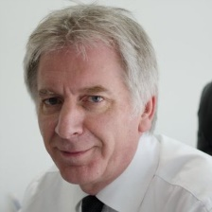
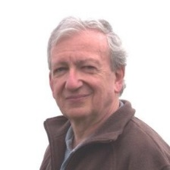
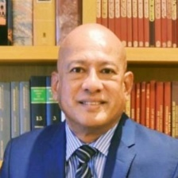
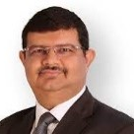
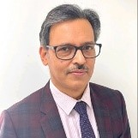
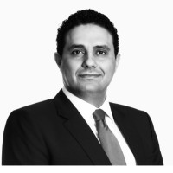
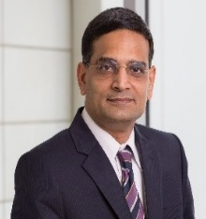
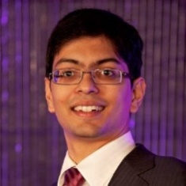
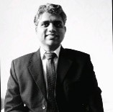
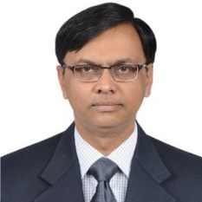
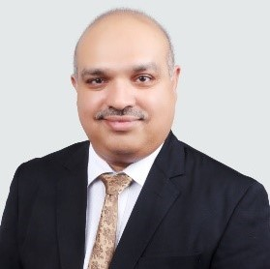
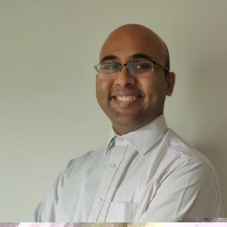
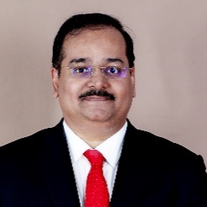
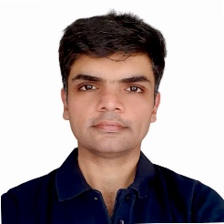
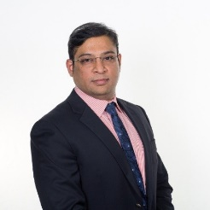
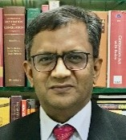
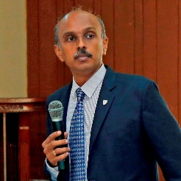
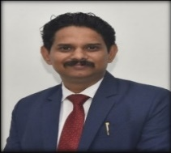
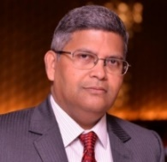
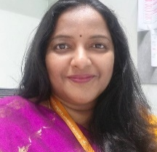
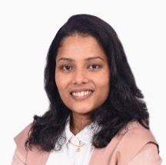
Confirmed Speakers (as of 17th Feb)
Phil Simons
Managing Director
C Cubed Consultants, UAE
Bill McLaughlin, Director of Courses, Advanced Training Services Maidstone, England, UK
Datuk Sundra Rajoo Director, Asian International Arbitration Centre, Kuala Lumpur
Tejas Karia,
Partner & Head, Arbitration
Shardul Amarchand Mangaldas
Ganesh Chandra Kabi,
Arbitrator & Arbitration Counsel
Kabi and Associates
Faisal Attia
Partner,
Pinsent Masons,
Dubai
Sampath Raman,
Operations Director,
MACE International Dubai
Anirudh Krishnan
Founding Partner
AK Law Chambers
Badri Srinivasan
Senior Manager (Legal)
Directorate General of
Hydrocarbons, MPNG
Dr Sridhar Mothe
Principal Consultant
Mothe Associates
Mayank Singh Takur
Delay Analyst, Masin
Ajay Nandalike
Partner, Pragati Law Chambers
Dr. Pradeep Reddy
Practicing Arbitration
Professional
Ronak Desai
Head, International
Construction Law Offices
Mustafa Hussain
Director, HKA, UAE
Awaiting confirmation from few more speakers from UK, Singapore and Dubai
Leading law firms, consultants and government organizations will be attending this event.
If you would like to associate with the conference email us at rama.venkat@manipal.edu or call +91 7358268089
Hasit B Seth
Independent Counsel,
Arbitrator and Mediator
Inbavijayan V
Independent Arbitrator and Mediator
Knowledge Partner
Media Partner
Organising Committee
SCAN & Register
Prof (Dr) Avinash Dadhich, Director, Manipal Law School
Prof R Venkat,
Professor of Practice-Law
Manipal Law School
Dr Anuja S
Associate Professor
Manipal Law School
Ms. Mohana Potdukhe
Civil Engineer & Lawyer
SCL, India

